Slide 1
Status report #6
2019.11.29 (Fri)
B4 FUJIWARA Tomomasa
ROOT・G4 seminar
Detector Seminar
Making Trigger scintillator

Slide 2
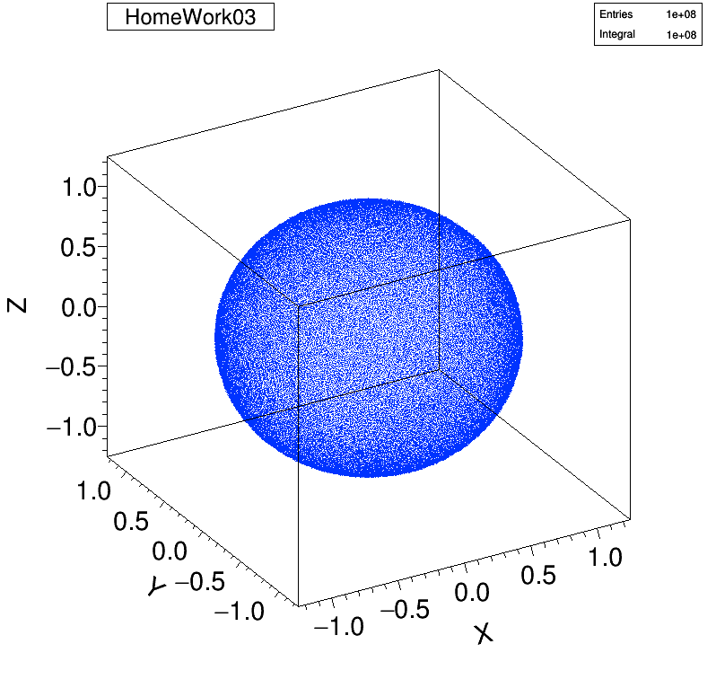
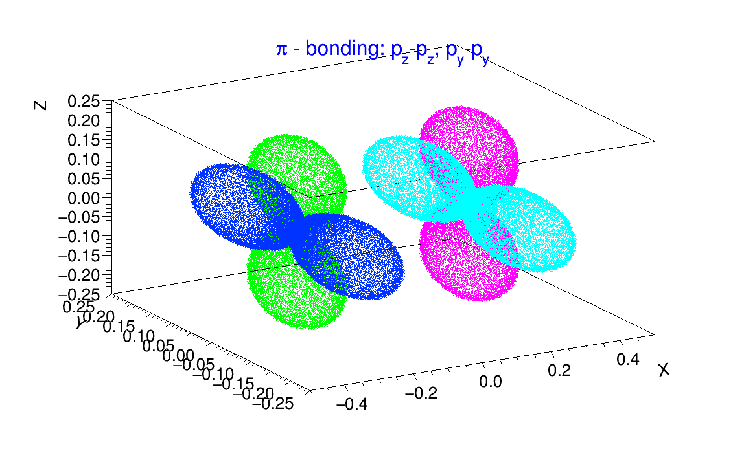
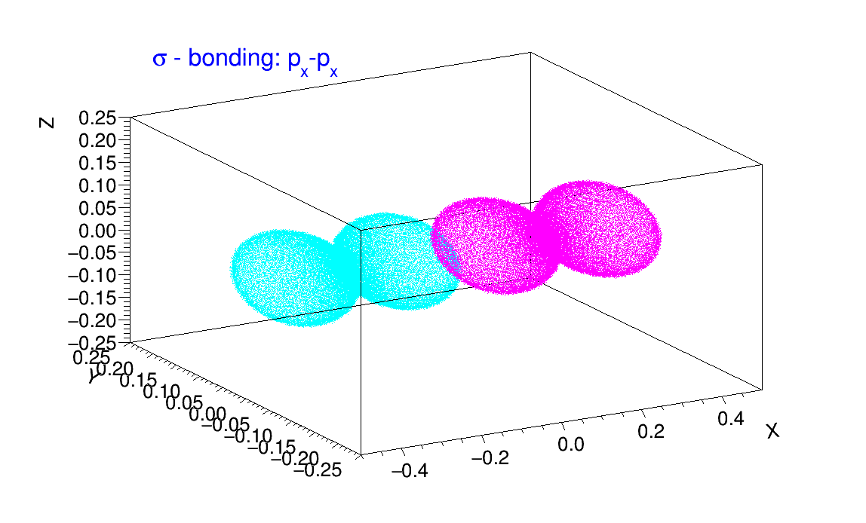
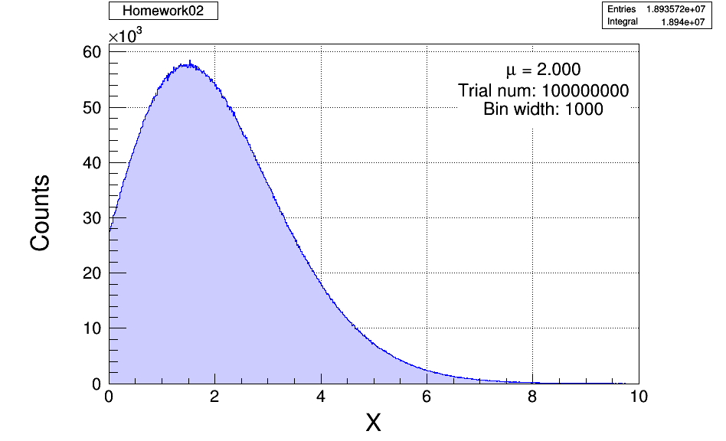
ROOT・G4 seminar

Slide 3
Making Trigger scintillator
Making Timing Trigger for ELPH beam time (12.19~12.21)
TOF Counter
T1
T2
Akiyama san’s
Water Cerenkov Counter

Slide 4
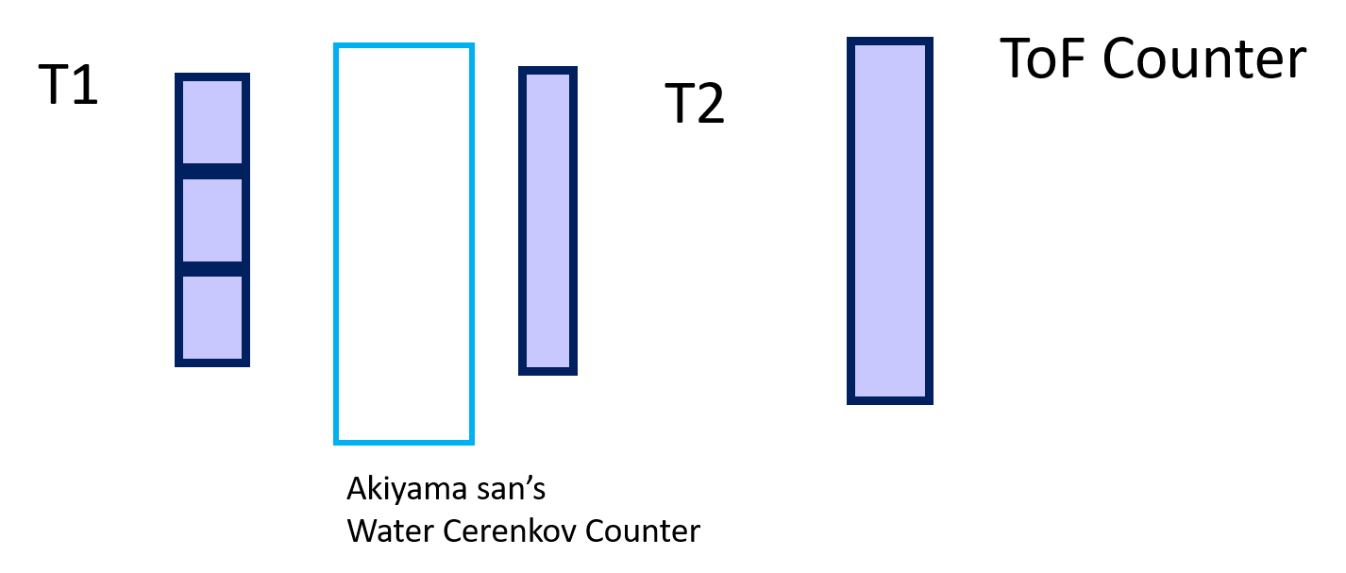
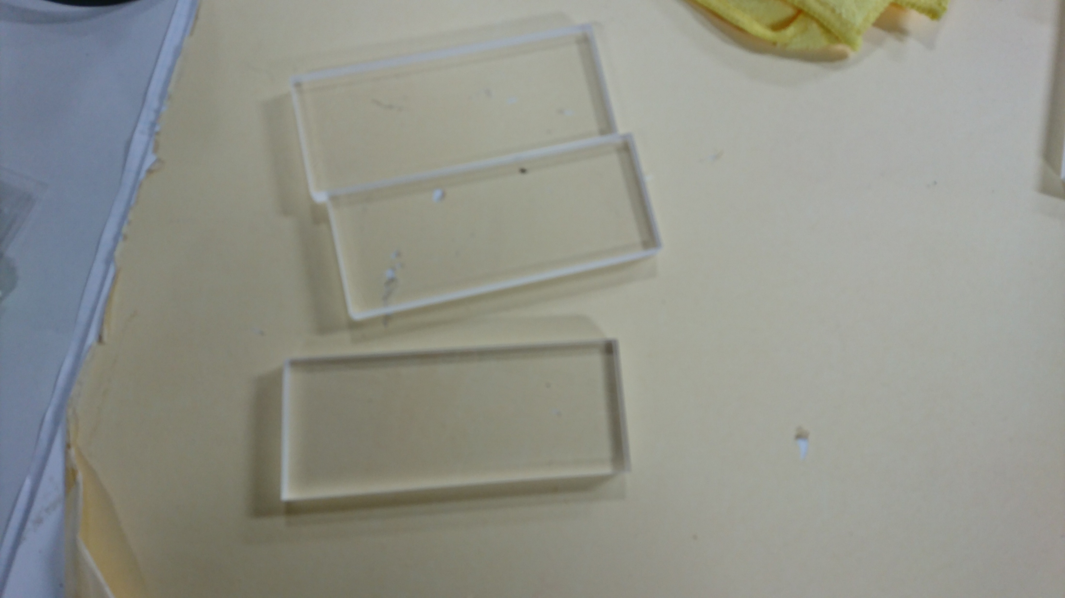
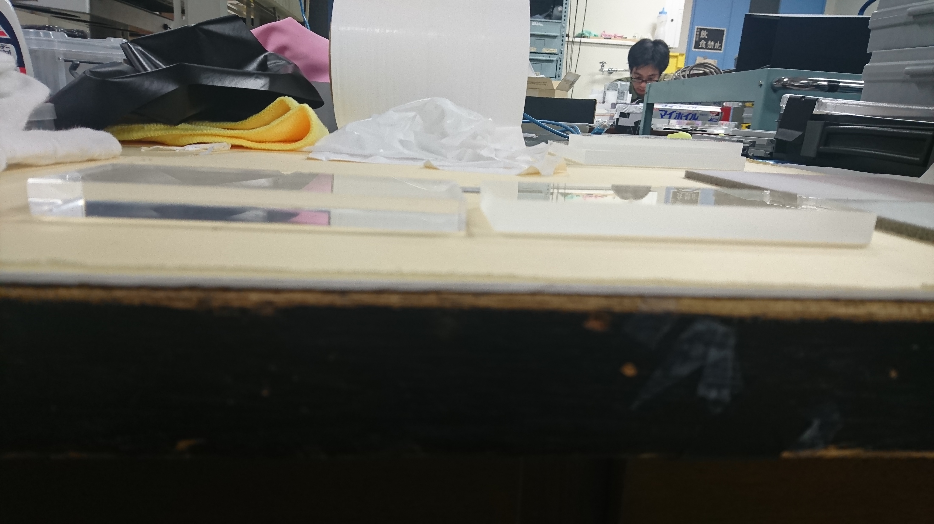
Making Trigger scintillator
Making T1
↑After polished (Left) , Before polished(right)
W: 120mm, H:48mm

Slide 5
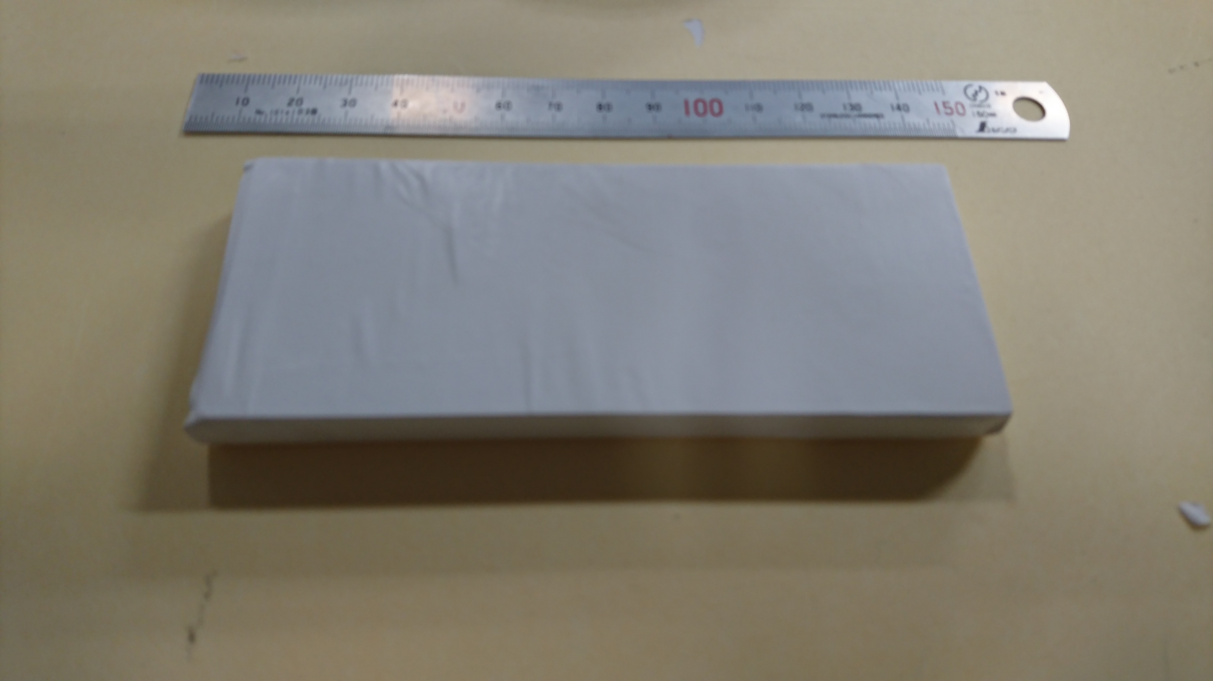
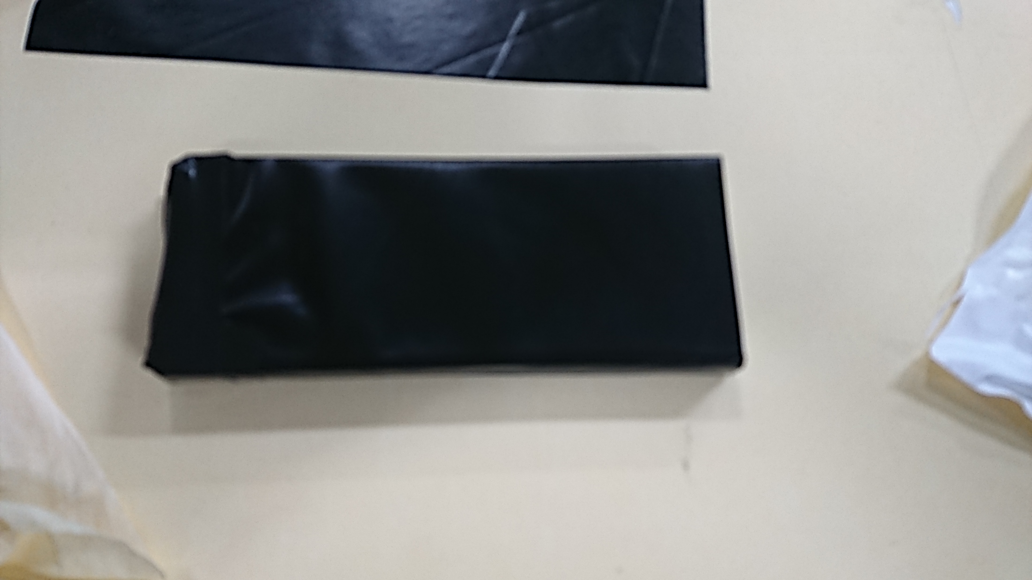
Making Trigger scintillator
Wrapping Teflon
Wrapping black vinyl

Slide 6
JPS entry
Title and abstruct: checked by Nagao-san
Title:
“ELPHにおけるΛハイパー核分光実験のための新TOF測定器の開発”

Slide 7
To do next
Continue to making T1(1 of 3 done) , T2, TOF ⇒ Install: 12.15?
Presentation: detector seminar
Report: 宇宙論, deadline: 12.6
Prepare for B4 Seminar

